Slide 1

MIN-291 Engineering Analysis and Design Course-Project
Analysis of a 1D Viscoelastic Bar under Axial Loads
Group 3 members:
Megha Choudhary 22117086
Mehul Sharma 22117087
Mohammad Sabir 22117088
Munnaluru Ruthika 22117089
Muskan 22117090

Slide 2
MIN-291 Engineering Analysis and Design Course-Project Group No: 3
Analysis of a 1D Viscoelastic Bar under Axial Loads
Motivation Many things of everyday life, such as polymers, biological tissues, foams, and gels, exhibit viscoelastic behavior. the significance of viscoelastic materials lies in their ability to provide controlled damping, energy absorption, and vibration isolation | Objectives 1. To analyze the dynamic response of a 1D viscoelastic bar subjected to axial loads. 2. To study the time-dependent behavior, stress relaxation, and creep effects of the material. 3. To generate time-dependent deformation plots.
Methodology The 1D analysis of the viscoelastic bar is performed using Ansys ( workbench 2022 r2) A viscoelastic material is chosen for the geometry The bar having a fixed support at one end and free at other end and a force is applied at the free end The desired deformation graphs are obtained by solving | Deliverables The deformation at different points of the bar are expressed by different colours Deformation time graph is obtained which show the deformation by the given forces as time passes Maximum, minimum, and average stress on the bar is obtained

Slide 3
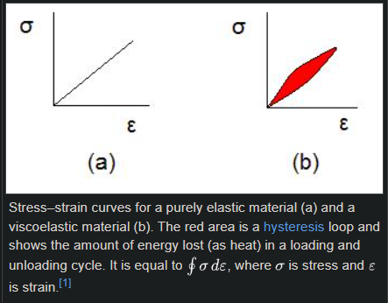
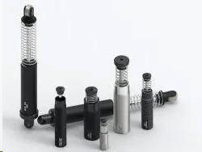
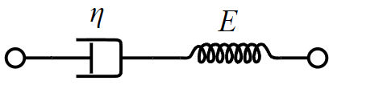
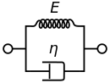
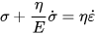
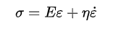
Viscoelasticity and its applications:
viscoelasticity is the property of materials that exhibit both viscous and elastic characteristics when undergoing deformation.
It shows 3 properties :
Hysteresis : viscoelastic substance dissipates energy when a load is applied, then removed
Creep : time dependent strain under constant stress
Stress relaxation : decrease in stress under constant strain
Linear viscoelasticity is when the function is separable in both creep response and load
Viscoelastic behavior has elastic and viscous components modeled as linear combinations of springs and dashpots, respectively
Maxwell model
Kelvin–Voigt model
Viscoelastic damper shock absorber
viscoelastic materials dissipate energy (Damping) when subjected to mechanical vibrations, making them ideal for damping applications in structures like buildings, bridges, and vehicles. Understanding viscoelastic properties is crucial in the field of biomechanics, where researchers investigate the mechanical behavior of biological tissues and organisms. NASA used a version of the material during a launch to protect a delicate camera from the many different shocks, vibrations and other forces that would be exerted on it.

Slide 4
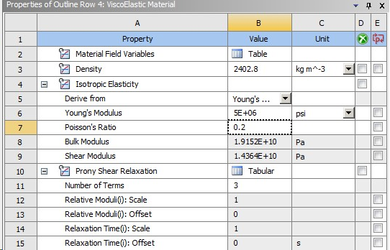
Analysis of 1-D viscoelastic bar
analysis was done in Ansys software
Geometry: 1-D rod
Material selected : viscoelastic material
(properties are shown in the figure)
Load applied :
2 types of load are applied :
Case 1: The Bar Is Fixed At One End And A Constant compressive load of 500N Is Applied For 100 Seconds At The Other End
Case 2: The Bar Is Fixed At One End And An Uniaxial Time Varying Load Is Applied On The Bar Which Linearly Increases For First 100sec Then Linearly Decreases For Another 300sec Till It Vanishes Then Stays 0 For Another 100sec
Case 3: The Bar Is Fixed At One End And A Displacement Of 30mm Is Given To The Other End

Slide 5
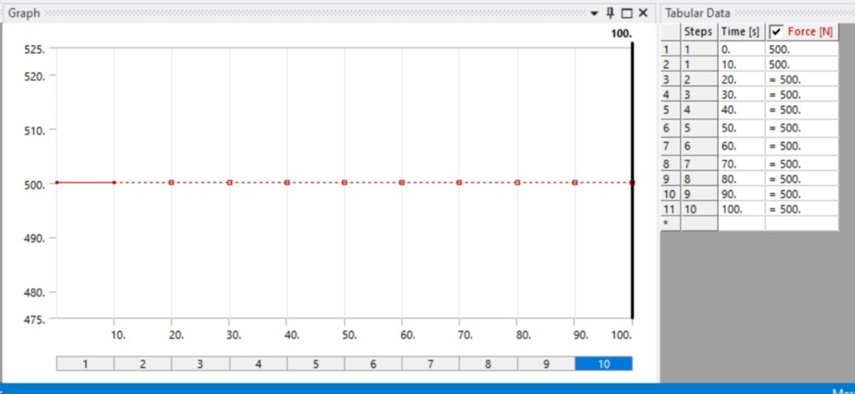
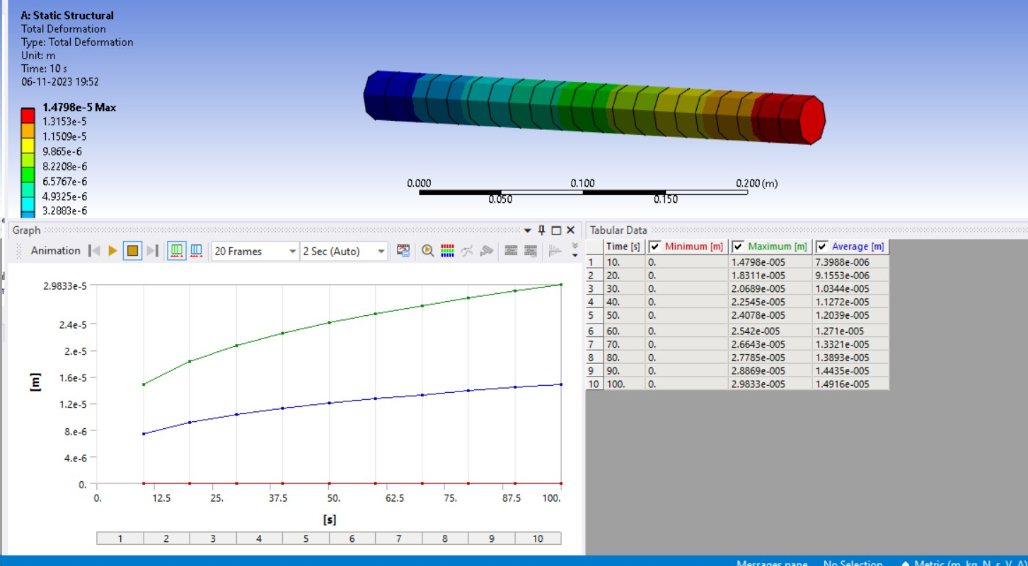
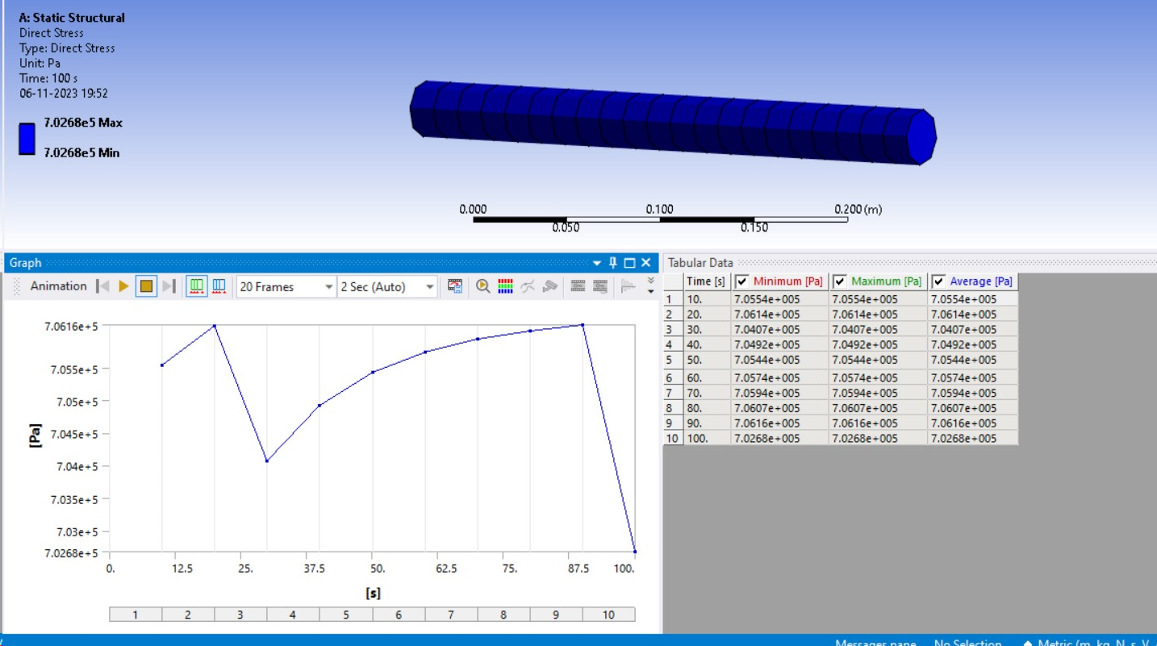
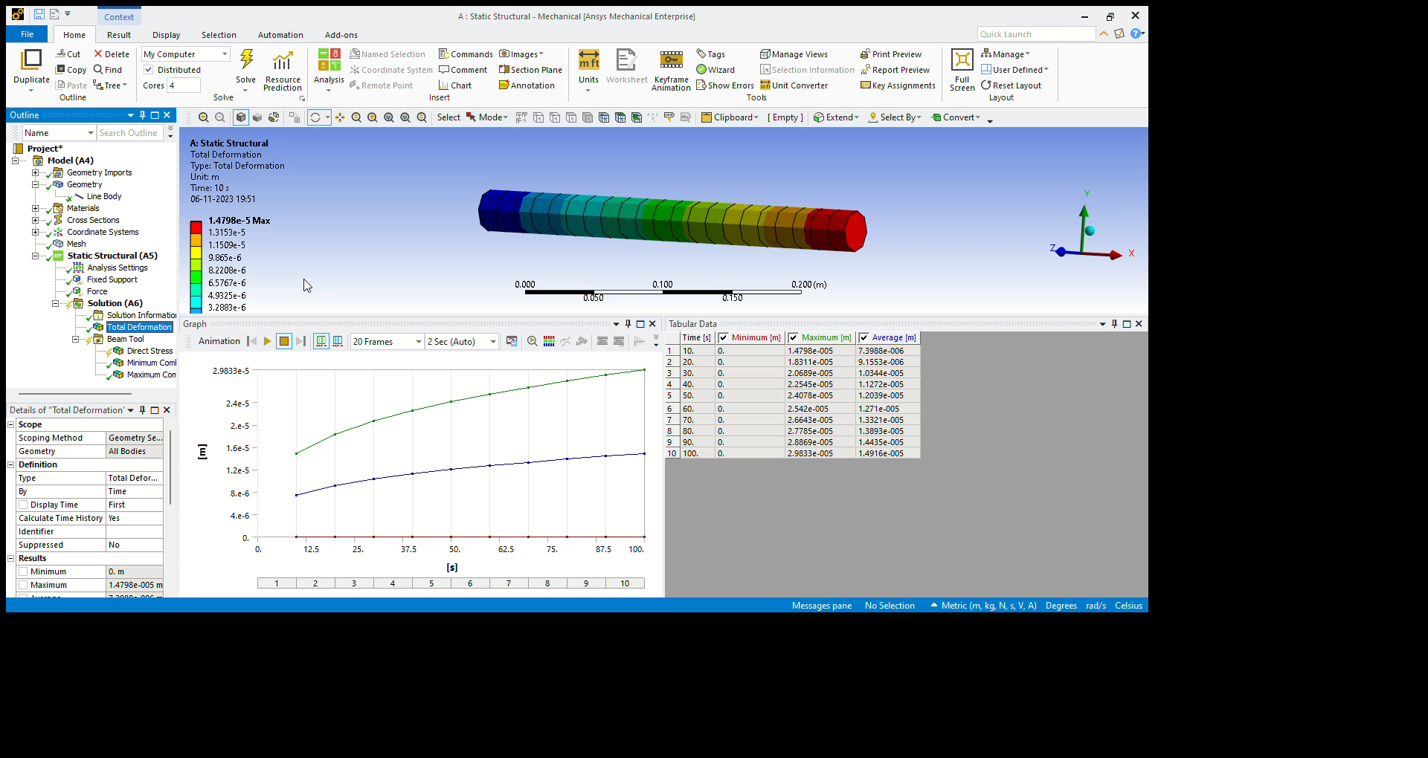
Results of case 1
Force vs Time Graph
Deformation vs Time Graph
Stress vs Time Graph

Slide 6
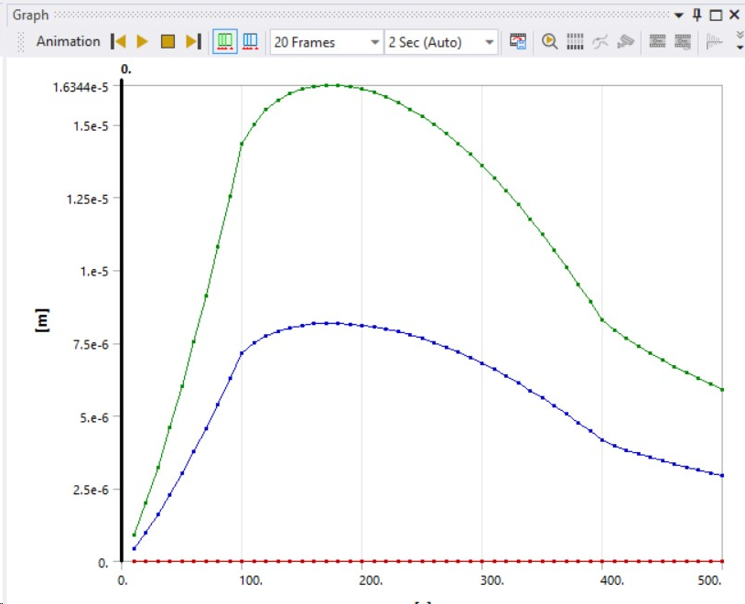
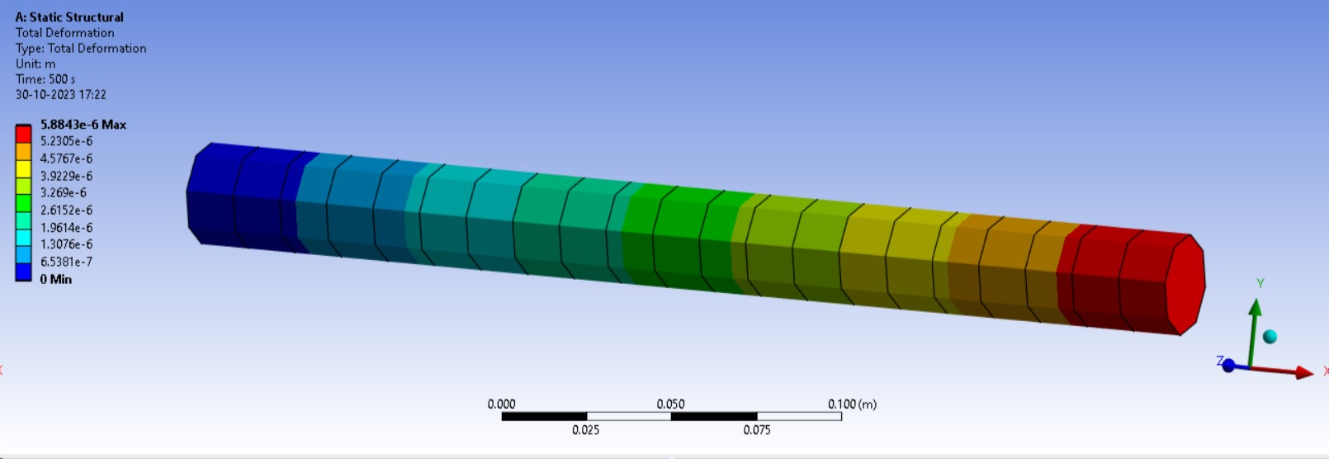
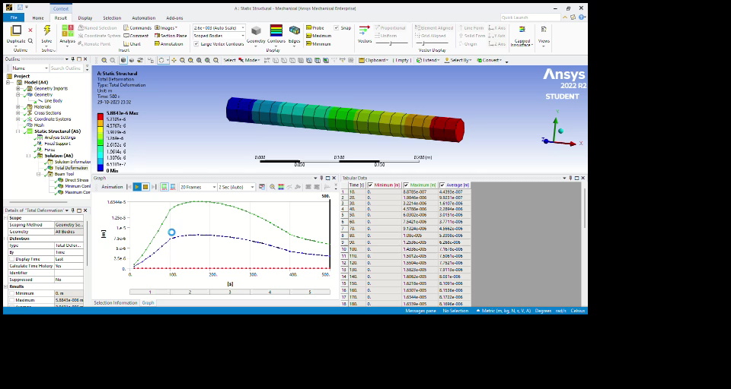
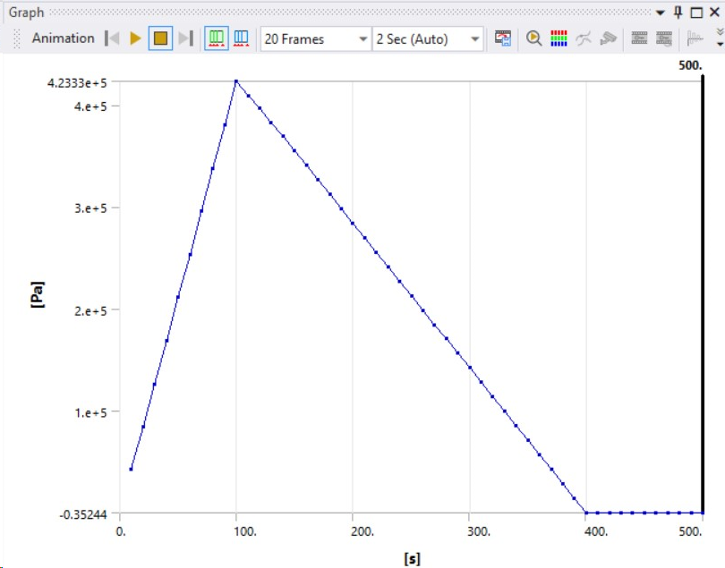
Results of case 2
Deformation on the rod
Total deformation graph
Stress vs time

Slide 7
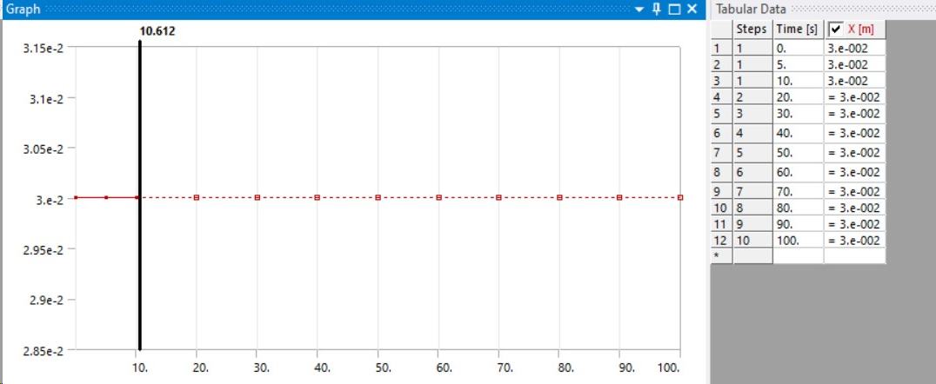
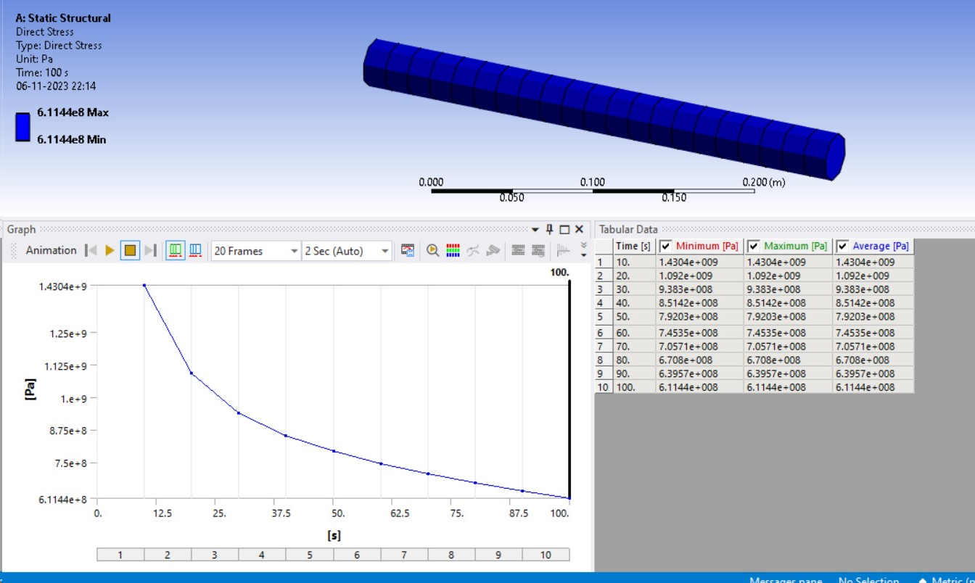
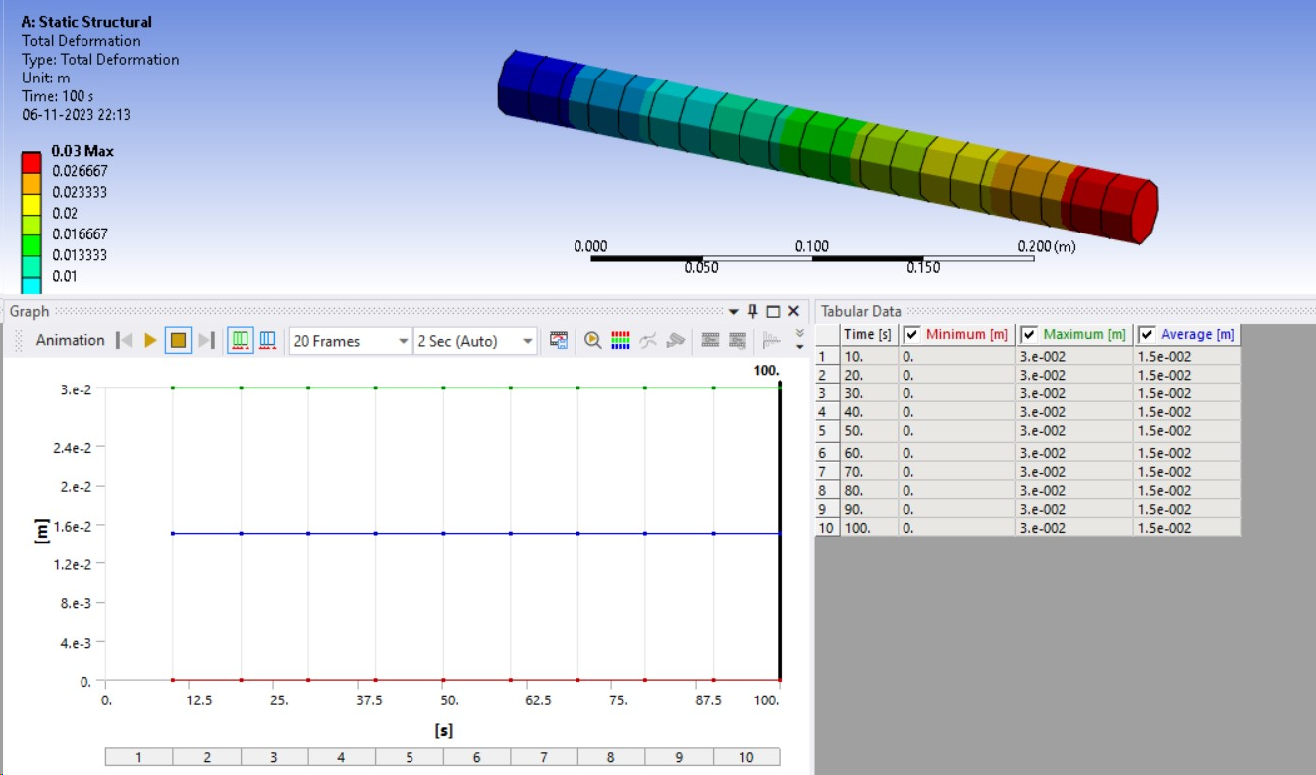
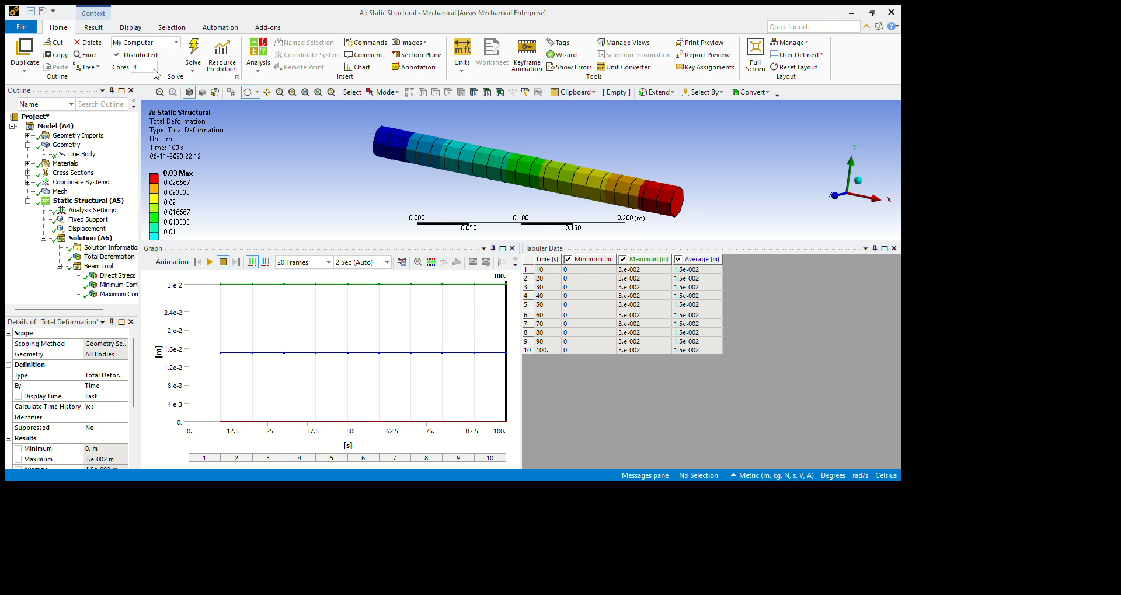
Results of case 3
Displacement vs Time Graph
Stress vs Time Graph
Deformation vs Time Graph
Animation Video

Slide 8
Conclusion
The different combination of viscous and elastic properties in materials are crucial in engineering, helping engineers design safer and more efficient structures. viscoelastic material shows properties such as hysteresis, creep and stress relaxation which make them ideal for many jobs such as dampers, shock absorbers, noise controllers, etc.
This project will help us understand the properties of viscoelastic materials in different situations and its vast scope.
Bibliography
https://www.sorbothane.com/technical-data/articles/visco-elastic-materials/#:~:text=Discovered%20and%20developed%20in%20the,from%20operating%20them%20in%20place.
https://en.wikipedia.org/wiki/Viscoelasticity
https://ansyshelp.ansys.com/account/secured?returnurl=/Views/Secured/main_page.html?lang=en
https://youtu.be/xCkRwjz5mGY?si=H1_aNGz6vpWcIKpI
https://youtu.be/EJxJlfAAW2g?si=YLAt9A0dN80X6qoN

Slide 9
Thank you

